Slide 1
LANGBOT
Capstone Presentation 1
Aastha, Isabel, Jess, Mon, Ram

Slide 2
LANGBOT
Chat-based conversations for language learning.
Language learning market size $190B by 2028.
Differentiation:
Cue-based learning
Interactive engagement
Always on language partner

Slide 3

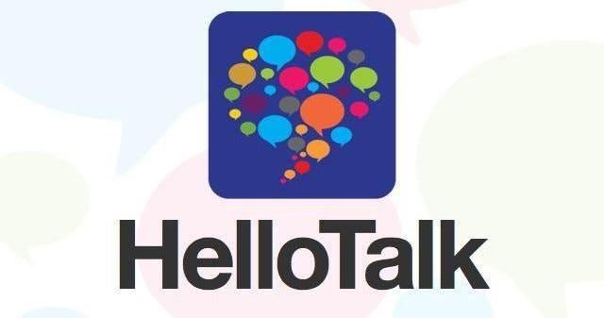



GOALS FOR LANGUAGE LEARNING
Cultural
Historical
and
Geographical Context
Enjoying cultural works such as Movies,
Pop Music, Literature
Thinking and responding in the target
language with in person or online
language partner
Conversational
Generative Communication
Memorization through repetition
and games
Functional
Vocabulary and Grammar

Slide 4
CONVERSATION KILLERS
Immersion is the fastest way to learn a language*
But there are many barriers to conversational practice
Time zones—Websites will connect you with native speakers but the timing can be difficult.
Peer Learning Limitations—Formal language classes pair students to practice conversations, but dialog and feedback is limited.
Form Factor Limits Habit—Unlike other types of eLearning, native conversations generally can’t take place on your commute or lunch break.
Poor Feedback—Existing chat models either don’t correct errors or directly correct errors without communicating.
Generative Conversations
Frequency of Communication
Interaction
Presence
Repetition
*Educational Psychology Review (2021) 33:937–958The Cognitive Affective Model of Immersive Learning (CAMIL): a Theoretical Research-Based Model of Learning in Immersive Virtual Reality

Slide 5
LANGUAGE LEARNER PERSONAS
Personal
Professional
High School 15M
and College Students
8M
Fostering Cultural and Family Connections
Travel/
Immigration
45M
Healthcare 15M /
Social Workers 187,000
NGO/
Diplomats/
Military
Business Professionals
9M
~92M US Language Learner Population, 27% of US
Personal market is larger with more budget control but both are sufficient populations
10% user adoption is 9M customers
1
Language learners with personal motivations have episodic needs:
Studying for a test
Planning a trip
Preparing for a visit
They tend to control their own budgets for language learning.
2
Professionals with language learning needs may have organizational support including development budgets and dedicated time for language learning.
Professionals may have long term needs to develop language skills.
NCEDS: High School and Beyond; CBO: The Foreign-Born Population, the U.S. Economy, and the Federal Budget; BLS: Healthcare Workers
Zippia: Licensed Social Worker Demographics in the US; America Council on the Teaching of Foreign Languages: Making Languages our Business;
1 in 4 business rely a lot on worker’s foreign language skills * 24M professional population with language skill needs

Slide 6
USER INTERVIEWS
 | Mallory | Michelle | Leanna | Tristan | Sofia
Target Language | Italian | French | English | Hindi | Spanish
Motivation | Professional-works at Italian preschool | Travel | Moved to the US | Enjoys Language Learning | Travel, Enjoys Language Learning
Resources | Rosette Stone, Duolingo, formal classwork | Duolingo Max, YouTube | ESL school classes, full immersion, books | Duolingo, Text Book, Hello Talk, Chat-GPT | Turned phone settings and websites to Spanish, Duolingo
Biggest Frustration | Pronunciation | Grammar and pronunciation | Felt shy due to English limitations | Getting tenses right, regional differences | Verb Conjugation
Moments of Delight | Understanding teachers in the break room | Being able to navigate a conversation in France | When you can connect and people understand you | Having meaningful conversations with language partners | Enjoys understanding and learning more
Would you use Langbot? | If it is part of the app i.e. Rosette Stone or Duolingo | If it was audio-based, not text-based | NA | Yes | “This would change my life!”

Slide 7




COMPETITIVE INSIGHTS
 | Duolingo | Hello Talk | Rosette Stone
Description | Language Learning App, Freemium Model $6.99/Month | Platform that pairs users trying to learn each other’s language, Freemium Model $12.99/Month | Web and app-based language learning Starting at $36/Month
Good for | Beginners and creating a habit | Conversations with native speakers | Pronunciation and ease of use
Limitations | Gamification is disliked by intermediate and advanced users | Talk time is split between the two languages, time zone dependent | Does not seem to be widely adopted
How we are different | Conversation-focus, cue learning | Conversations have 24/7 availability | Lesson-based

Slide 8
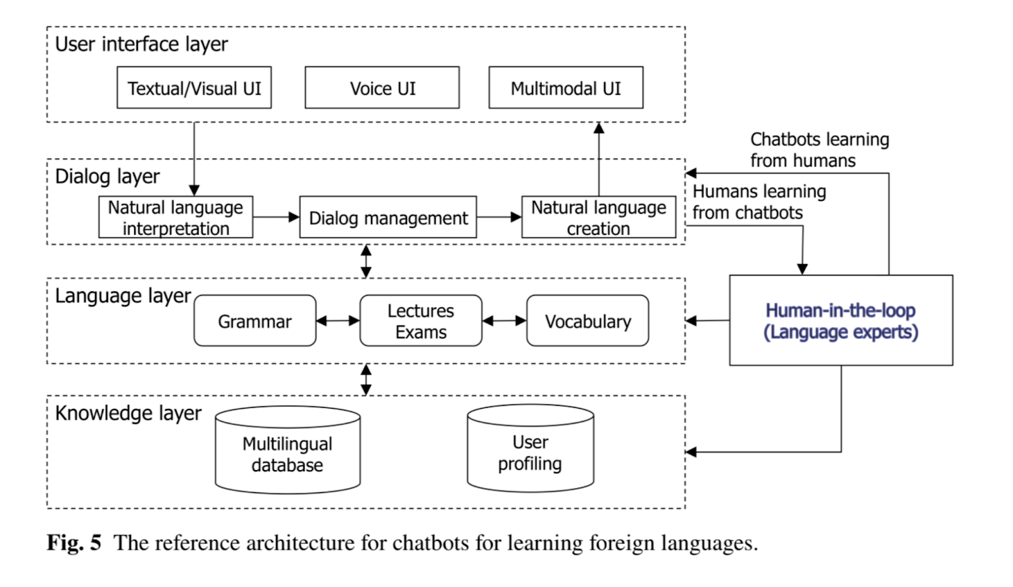
SECONDARY RESEARCH
The Role of Chatbots in Foreign Language Learning: The Present Situation and the Future Outlook
Chatbots for language learning—Are they really useful? A systematic review of chatbot-supported language learning
Three major learner benefits of language chat bots:
timeliness,
ease of use, and
personalization
And five teaching uses:
as conversation partner,
as simulations, for transmission,
as helplines, and
for recommendations.

Slide 9
CONVERSATIONAL WORKFLOW EXAMPLE
Conversation Lesson
Practice the Conversation
Lesson 1
Greeting
Hello! I'm Léa, your language tutor.
A: Hello! I'm Léa, your language tutor.
B: Hello Léa! I’m Mon, nice to meet you.
A: Welcome to the course!
Hello, Nac to meet you.
Transition to conversational learning
cue-based learning
Sorry, what does Nac mean? Is it a spelling error?
Sorry, I mean Nice to meet you.
Welcome to the course!
Notes:
Our webapp
vocabs = hello, I am, your, nice to meet you, welcome
grammars = I am, welcome to, the course

Slide 10
ARCHITECTURE
Flask App
Models
Content Classification Is the response on topic? |  | Grammatical Error Correction Model Is the response correct? |  | LLM indirect cue-based learning How do I tell the user?
Hello! I’m Lea, the teacher. Response: Hello, Nac to meet you. | In target language? Yes Relates to conversation lesson script? Yes | Hello! I’m Lea, the teacher. Response: Hello, Nac to meet you. | Is the response grammatically correct? No. The word choice is incorrect. | The response word choice is incorrect. Hello! I’m Lea, the teacher. Response: Hello, Nac to meet you. | Sorry, what does Nac means? Is the word choice incorrect?
Hello! I'm Léa, the teacher.
Hello, Nac to meet you.
User Input
Model Output
what does Nac means?

Slide 11
BEHIND THE SCENES
Flask App
Models
Content Classification Is the response on topic? |  | Grammatical Error Correction Model Is the response correct? |  | LLM indirect cue-based learning How do I tell the user?
Hello! I'm Léa, your language tutor.
Hello, Nac to meet you.
User Input
Model Output
Sorry, what does Nac mean? Is it a spelling error?

Slide 12
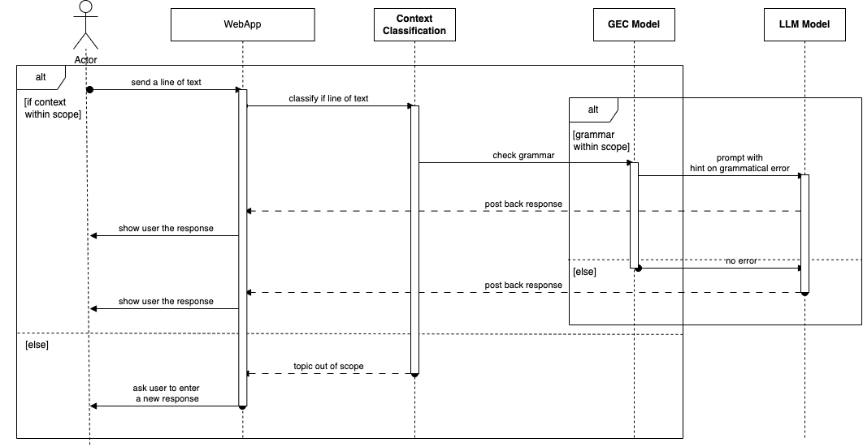
SEQUENCE DIAGRAM

Slide 13
DEFINING THE MVP
Langbot allows language learners to practice conversations any time any where
In Scope
Open Access Website: can support a limited
set of alpha users.
Cue-learning Corrections: users will get helpful
prompts to correct mistakes.
US Market: targeting Spanish language learners
Reasonable response time: users will not
experience model delays, targeting <1 sec
response time
Generative Conversation: 1-2 scenarios
users can converse in dynamic conversation
Backlog
Push button audio: User can click on any string of dialog to hear it pronounced.
Multiple levels of conversations: Beginner conversations are more gamified. More advanced conversations allow users to learn and discuss new topics.
Increase Learning Speed
Reduce Conversational Friction
Increase Learning Satisfaction

Slide 14
ROADMAP
MVP P0
P1
P2
Beginner lesson in Spanish (2+ lessons offered)
Cue based feedback
If a user answers a question incorrectly 3 times, we give them the right answer and move on
Incorrect means context is off or the grammar is off.
Once a lesson is completed, we should have a modal that pops up (or something similar) to celebrate the end of the lesson
Need a screen that allows for users to view the lessons and choose the lesson that they want to start (kind of like a lobby)
Home screen for what we are, how our product is different, about us
Suggestions button if the user is stuck
Click to Translate capabilities
Click to speak out loud
Different levels of lessons (beginner, intermediate, etc)
Personalization for mistakes
Login and saving and remembering user progress
Ability to see past conversations
Modeling the conversation ahead of actual conversation
Different languages offered
Image based vocab
Chatting with friends aside from lessons
AI lessons
Incorporating these technologies into
existing voice assistant technologies, (ex.
Siri and Alexa) to embed practice

Slide 15
DATA SETS
Spanish GEC dataset, Spanish SEC dataset
The Corpus Of Written Spanish – L2 and Heritage speakers (COWS-L2H) - 3,516 essays from 1,370 individual students enrolled in university-level Spanish courses in the United States. Of these, 1,695 essays, consisting of 33,950 sentences, from 737 students are currently available in the project repository. Annotated with errors and corrected versions. Available on GitHub.

Slide 16
ETHICAL CONSIDERATIONS
Algorithmic Bias has been observed in machine translation and chat bots.
Unintentionally teach inappropriate or offensive language.
Potential displacement of human language teachers.
Ensuring a safe and effective learning environment.
Notes:
here I want to talk about some ethical consideration we have to be aware of when we are developing our product.
1) Bias in language models since LLM Models train on large amount of data from the internet. and these models may encoded the biases that exist in the data.
2) Be aware of the risk of teaching inappropriate or offensive language unintentionally
Also is the potential displacement of language teachers as language applications become more sophisticated and accessible
4) ensuring a safe and effective learning environment. whcih includes protecting our user data

Slide 17
PROJECT PLAN (IN PROGRESS)
Start Here
Fine tune a foundational large
language model for error
detection.
Prompt engineering to leverage
one of the GPT models to
generate responses for user inputs
as well as cues based on identified
errors.
Phase 1
1
4
2
Phase 4
Phase 2
Final presentation
P1 and final testing
Align on architecture and design—considering AWS Amplify and Sagemaker
Technical presentation
Finalize MVP
Complete user testing
Reset roadmap to address feedback
Phase 3
3
Notes:
divide in 4 phase.
phase 1：
completed the 3 models decribe
Fine-tune a foundational large language model to detect grammatical error
Leverage the GPT model to generate cue based responses based on the identified errors.
phase 2：objective
Review and understand the capabilities or limitations of AWS Amplify and Sagemaker.
Align on the architecture and design and prepare a technical presentation
phase 3：
Finalize MVP development ; Conducting user testing ; Gather and analyze feedback from the test users
and Reset the project roadmap based on those feedback.
phase 4:
wrap up the final testing; and deliver the final presentation

Slide 18

ROLES
PRODUCT
DATA
SCIENCE
APP DEV
ML ENGINEERING
DATA
ENGINEERING
PROJECT
MANAGEMENT
Jess
Backup: Ram
Ram
Backup: Jess
Aastha
Backup: Isabel
Isabel
Backup: Mon
Mon
Backup: Aastha

Slide 19
ASKS FOR SUPPORT
Feedback from language domain experts
NLP/SME professors for suggestions and feedback
Business side experts
Language learners for ongoing feedback and testing
Language Professors
NLP Professors
EdTech
LLM-focused PMs
US-based Spanish Learners
Notes:
some groups that we supports
feedback from language domain experts: language professor
model feedback / suggestion from nlp professor
business experts: align our project with the current trends and demands in the edtech industry.
language learner that will help us testing
Thank you for your attention, and I am now open to any questions .

Slide 20
Thank You!

Slide 21
10/12/2023 - Capstone Updates
9/27 - talked to edTech founder Ted Song
10/4 - talked to Stanford Linguistics professor Lee Dennig
10/10 - talked to professor Mark Butler
Name change: conversationally or conversationly

Slide 22


Our web app

Slide 23
Discussion with professor Dennig
The key to conversational language learning
Let AI keep talking and not correcting student's mistakes. AI responds by repeating what the student said in a correct grammatical form and having the AI build up the conversation from that. It then presents a summary and explanations of mistakes that the student made. Log it so the student can always return to it as part of the personalization. This is called the scaffolding method or indirect learning, indirect method.
Recommended language learning flow
Lessons in micro conversation dialogues. Allow students to hear the conversation -> learn key vocabs and grammar -> go through the dialogue again and be familiar with it -> some practice questions about the conversation dialogue.
Practice the conversation between students.
The third phase is using our AI chatbot, as it won't tire of practicing conversation with students. It is adaptive, conversational, compared to human tutor
The conversation dialogue script in the lesson
make sure it has a good subject, verb, and object grammatical layout
has two grammatical rules that students can learn
has the order of words

Slide 24
CONVERSATIONAL WORKFLOW EXAMPLE
Conversation Lesson
Practice the Conversation
Lesson 1
Greeting
A: Hello! My name is Léa. What is your name?
B: My name is Mon.
A: Oh! Your name is Mon. Nice to meet you. How are you?
B: I am fine, thank you.
Hello! My name is Léa. What is your name?
I name is Mon.
Transition to conversational learning
scaffolding learning
Oh! your name is Mon. My name is Léa. Nice to meet you. How are you?
I am fine. Thank you.
Notes:
Our webapp
vocabs = hello, I am, your, nice to meet you, welcome
grammars = I am, welcome to, the course

Slide 25
BEHIND THE SCENES
Flask App
Models
Content Classification |  | Grammatical error correction |  | LLM Scaffolding Learning
sentence transformer model |  | GEC with Explanation model |  | llama v2 with prompt engineering
Is the response on topic? No |  | Is the response correct? |  | How do I tell the user?
Hello! My name is Léa. What is your name?
I like sports
User Input
Model Output
Interesting. What is your name?

Slide 26
BEHIND THE SCENES
Flask App
Models
Content Classification |  | Grammatical error correction |  | LLM Scaffolding Learning
sentence transformer model |  | GEC with Explanation model |  | llama v2 with prompt engineering
Is the response on topic? YES |  | Is the response correct? NO |  | How do I tell the user?
Hello! My name is Léa. What is your name?
I name is Mon.
User Input
Model Output
Oh! your name is Mon. My name is Léa. Nice to meet you. How are you?
log it

Slide 27
DATASET for GEC with Explanation
{
"target": ["It", "has", "a", "high", "-", "density", "population", "because", "of", "its", "small", "territory", "."],
"source": ["It", "has", "a", "high", "-", "density", "population", "because", "[NONE]", "its", "small", "territory", "."],
"correction_index": [8, 22],
"evidence_index": [7, 9, 10, 11, 21, 23, 24, 25],
"error_type": "Preposition",
"predicted_parsing_order": {"1": 3, "5": 2, "7": 2, "8": 1, "9": 3, "10": 2, "15": 3, "19": 2, "21": 2, "22": 1, "23": 3, "24": 2},
"origin": "A"
}
"target" is the corrected sentence, with the corrected words indexed with "correction_index".
"source" is the erroneous sentence, with the erroneous words also indexed with "correction_index".
"correction_index" is the index of corrected and erroneous words, where the target and source sentences are concatenated with a separation token in between.
"evidence_index" is the index of evidence words for both the target and source sentences, where the target and source sentences are concatenated with a separation token in between.
"error_type" is the class of the error type.
"predicted_parsing_order" represents first-order dependent words (Number 2) and second-order dependent words (Number 3) in the dependency parse tree. Number 1 represents the position of the corrections.
"origin" is the learner's CEFR proficiency, which corresponds to W&I+LOCNESS.

Slide 28
Tasks
continue working on our feature engineering
build our GEC with explanation model
evaluate our sentence transformer model’s accuracy

Slide 29
LANGBOT
10/19/2023 - Capstone Updates
Aastha, Isabel, Jess, Mon, Ram

Slide 30
Recap
Cue Based Interactive Chatbot
Beginner Spanish Learner
LLMs & Generative AI powered Web Application
COWS-L2H Dataset
Three ML Tasks
Content Classification
Error Detection
Response Generation
Hello! My name is Léa. What is your name?
I name is Mon.
Oh! your name is Mon. My name is Léa. Nice to meet you. How are you?
Notes:
We are team Langbot working on a cue based interactive chatbot for beginner Spanish language learners.
We are building a web application powered by LLMs and Generative AI using the Corpus Of Written Spanish, L2 and Heritage Speakers dataset (COWS-L2H) from UC Davis. It contains Spanish college essays annotated with errors and corrections.
At a high level, we want our bot to
take an input from user
analyze errors
return cues about errors
return meaningful response to keep the conversation going.
We have identified three ML tasks:
Content Classification
Error detection and
Response generation

Slide 31
Content Classification Task
Goal: Is user’s response on topic?
Approach: Compute sentence embedding and compare to embeddings in VectorDB
Embeddings Choices:
Skip-Thought Vectors using encoder-decoder
InferSent using BiLSTM network
Universal Sentence Encoder using Transformer
Bert Embeddings (average of BERT output layer)
Sentence-BERT - BERT modified with siamese and triplet network structures.
Distance Metrics: Cosine and Manhattan distances
Our Pick: SOTA Sentence-BERT and Cosine Distance
Challenges: Response with multiple sentences, linking answers to questions.
10/19/2023 - Capstone Updates
Notes:
The Goals of Content classification task is to identify if input from user is on topic.
Our approach is to compute embeddings of the input and compare it to pre-computed embeddings stored in a vector db.
We looked at a few different options for the embeddings and selected SentenceBERT which was trained on parallel BERT networks and triplet loss function. It is the state of the art for several semantic textual similarity tasks.
We also selected cosine distance as the distance metric as it does a better job at semantic similarity.
We are still working through a few challenges like handling multiple sentences in user input and as well as question-answering.
More details on embeddings:
Skip-Thought uses an encoder-decoder architecture to predict the surrounding sentences
InferSent uses a siamese BiLSTM network with max-pooling over the output trained on SNLI dataset
Universal Sentence Encoder uses a transformer network
Bert Embeddings are average of the BERT output layer
parallel BERT follows siamese architecture

Slide 32
Error Detection Task
Goal: Identify and classify errors in user response
Approach: Grammatical Error Correction (GEC)
Model Choices:
Massively Multilingual Pre-trained Text-to-Text Transformer model with encoder-decoder arch
Encoder only BERT based model fine tuned for subsequence tagging and classification
Our Pick: Fine tune BETO (BERT based Spanish) model per existing research
Challenges:
Spanish dataset not on par with English dataset used in the paper. Needs feature engineering.
Class imbalance
10/19/2023 - Capstone Updates
Notes:
Next we have the error detection task which focuses on identifying and classifying any errors in user input.
We are relying on Grammatical Error Correction techniques for this task.
We identified two different approaches
One is to treat it as a Neural Machine Translation task and use a Seq2Seq or an encoder-decoder model
Another is to consider it as a subsequence-classification task and use a decoder only model with softmax layer on top.
As we discussed last week, we have identified a previous research that uses the second approach for English, giving us a good starting point. We are going to fine tune BETO, which is a BERT model trained on large Spanish corpus, on COWS-L2H dataset.
We have a few challenges though:
the COWS-L2H dataset is not on par with the research dataset. Needs feature engineering which I will cover in just a bit.
We also have a class imbalance issue with our dataset.

Slide 33
Response Generation Task
Goal: Generate Cue/Scaffolding as well as response
Approach: LLMs and few shot learning with output from GEC model
Model Choices:
GPT3.5/GPT4
Llama
Falcon
Aguila
Our Pick: TBD
Challenges: Trying out various models and manually evaluating results.
10/19/2023 - Capstone Updates
Notes:
The last task for us is to generate the response displayed to the user
This is a pure generative task and we are exploring few shot learning with multiple LLMs.
Biggest challenge with this task is that it needs manual evaluation.

Slide 34
Combined Response Generation
Goal: Identify errors, generate cues and response in one go
Approach: Content generation using generative AI - Few shot learning with LLMs
Model Choices:
GPT3.5/GPT4
Llama
Falcon
Aguila
Our Pick: TBD
Challenges: Prompt engineering
10/19/2023 - Capstone Updates
Notes:
We are also experimenting with collapsing error detection and content generation into one step using few shot learning and multiple LLMs

Slide 35
Feature Engineering
GEC model:
Convert COWSL2H dataset to match EXPECT dataset from paper
Evidence words
EXPECT has evidence words from annotators
Spanish dataset does not have evidence words
ChatGPT with few shot learning shows promise in generating evidence words
Dependency parsing tree
Spanish language dependency parsers are not as mature
Experimenting with Transition-based MaltParser and Maximum Spanning Tree Parser
The other two ML tasks do not need feature engineering.
10/19/2023 - Capstone Updates
Notes:
Next I would like to touch on feature engineering. Last week we presented details about the COWS-L2H dataset itself. Since then we have identified a few more tasks around transforming and enhancing the dataset to match what was used for the reference research. Two of the main ones are
identifying evidence words for an error. Ideally we would prefer using annotators for this. Since we are short on resources, we are exploring using Chat-GPT. It showing some promise.
next is generating dependency parse tree which represents the syntactic structure of a sentence. We are evaluating few Spanish dependency parsers for this.

Slide 36
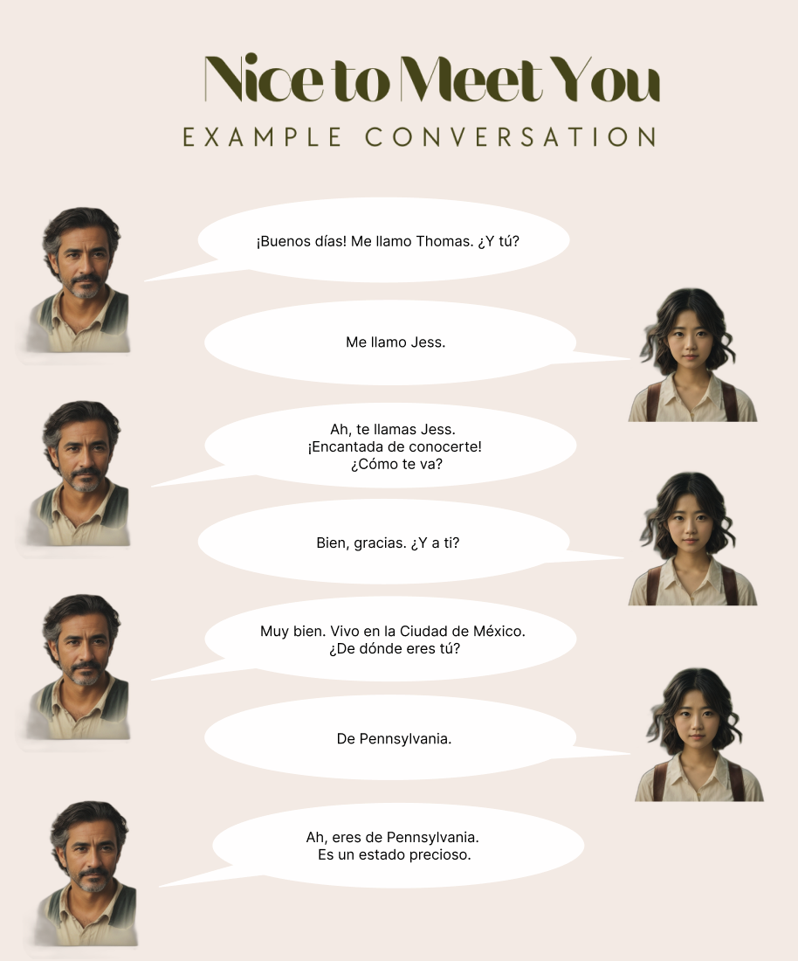
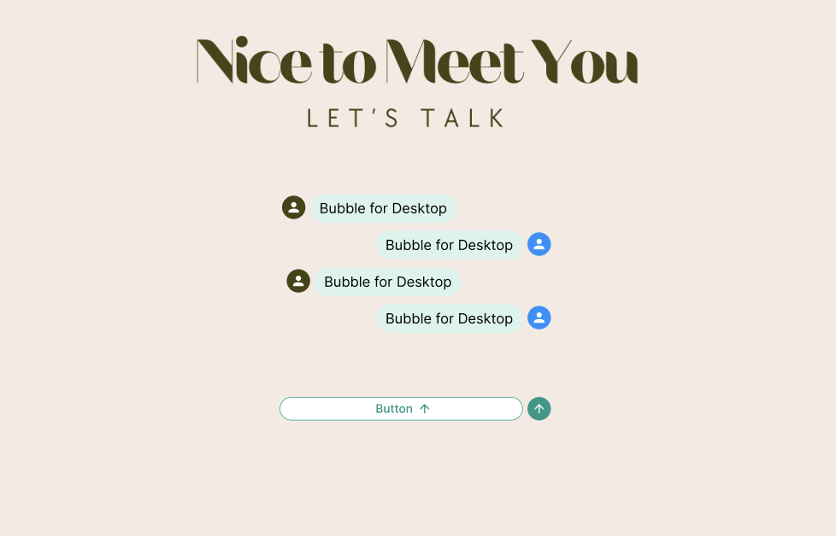
User Experience
10/19/2023 - Capstone Updates
Notes:
We also have some incremental progress on the user experience front
These two screenshots show what user sees before and during a session
The example conversation on left sets the context of the lesson
The chat UI on the right allows user to follow the example and interact with the bot

Slide 37
References
Davidson, S., Yamada, A., Mira, P.F., Carando, A., Gutierrez, C.H., & Sagae, K. (2020). Developing NLP Tools with a New Corpus of Learner Spanish. International Conference on Language Resources and Evaluation.
Kiros, R., Zhu, Y., Salakhutdinov, R., Zemel, R.S., Urtasun, R., Torralba, A., & Fidler, S. (2015). Skip-Thought Vectors. Neural Information Processing Systems.
Conneau, A., Kiela, D., Schwenk, H., Barrault, L., & Bordes, A. (2017). Supervised Learning of Universal Sentence Representations from Natural Language Inference Data. ArXiv, abs/1705.02364.
Cer, D.M., Yang, Y., Kong, S., Hua, N., Limtiaco, N., John, R.S., Constant, N., Guajardo-Cespedes, M., Yuan, S., Tar, C., Sung, Y., Strope, B., & Kurzweil, R. (2018). Universal Sentence Encoder. ArXiv, abs/1803.11175.
Reimers, N., & Gurevych, I. (2019). Sentence-BERT: Sentence Embeddings using Siamese BERT-Networks. Conference on Empirical Methods in Natural Language Processing.
Sun, X., Ge, T., Ma, S., Li, J., Wei, F., & Wang, H. (2022). A Unified Strategy for Multilingual Grammatical Error Correction with Pre-trained Cross-Lingual Language Model. International Joint Conference on Artificial Intelligence.
Xue, L., Constant, N., Roberts, A., Kale, M., Al-Rfou, R., Siddhant, A., Barua, A., & Raffel, C. (2020). mT5: A Massively Multilingual Pre-trained Text-to-Text Transformer. North American Chapter of the Association for Computational Linguistics.
Fei, Y., Cui, L., Yang, S., Lam, W., Lan, Z., & Shi, S. (2023). Enhancing Grammatical Error Correction Systems with Explanations. Annual Meeting of the Association for Computational Linguistics.
Muntsa Padró, Miguel Ballesteros, Héctor Martínez, and Bernd Bohnet. 2013. Finding Dependency Parsing Limits over a Large Spanish Corpus. In Proceedings of the Sixth International Joint Conference on Natural Language Processing, pages 942–946, Nagoya, Japan. Asian Federation of Natural Language Processing.
Cañete, J.L., Chaperon, G., Fuentes, R., Ho, J., Kang, H., & P'erez, J. (2023). Spanish Pre-trained BERT Model and Evaluation Data. ArXiv, abs/2308.02976.
10/19/2023 - Capstone Updates
Notes:
That concludes our presentation. We would like to take any questions now.

Slide 38
10/26/2023 - Capstone Updates
modeling progress
observations on modeling

Slide 39
Model Progress - Content Classification
Goal: Is user’s response on topic?
Approach: Compute sentence embedding and compare to embeddings in VectorDB
Model: Sentence Transformers with Retrieval-augmented generation (RAG): based on Sentence-BERT: Sentence Embeddings using Siamese BERT-Networks
sentence-transformers/multi-qa-MiniLM-L6-cos-v1
It maps sentences & paragraphs to a 384 dimensional dense vector space and was designed for semantic search. It has been trained on 215M (question, answer) pairs from diverse sources.
Synthetic Data generated with chatGPT v4
5 iterations of user’s response in JSON format. We plan to expand this dataset.
Retrieval-augmented generation (RAG)
Find the similarity score

Slide 40
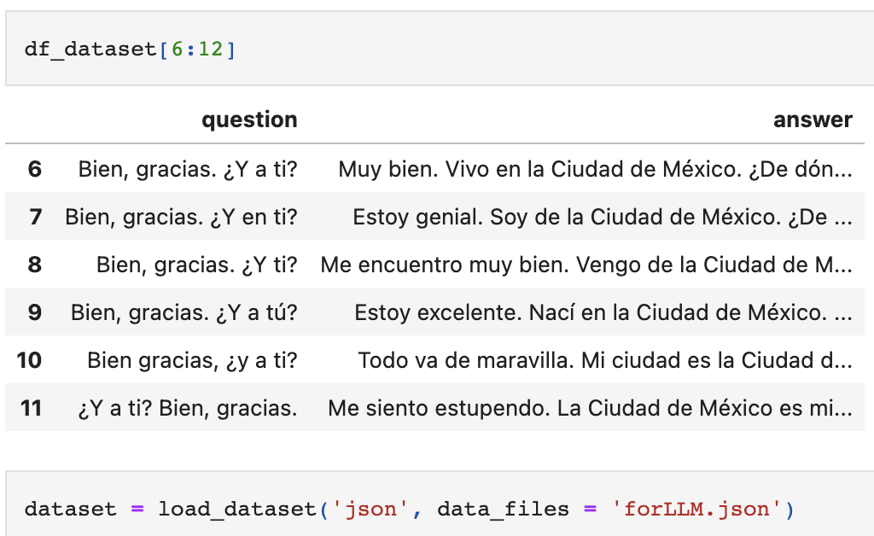
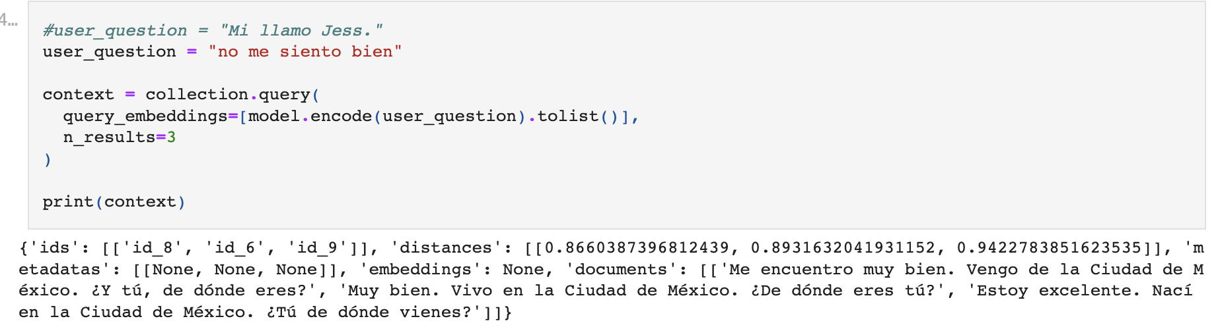
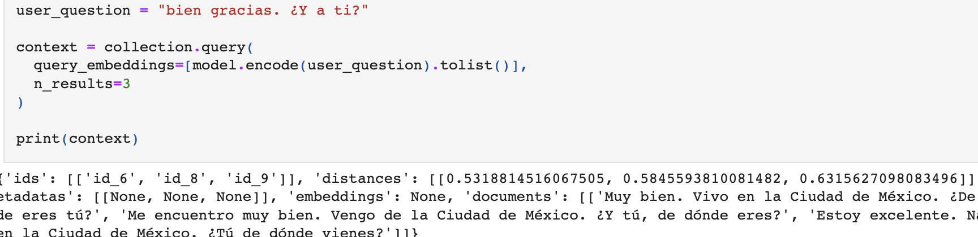
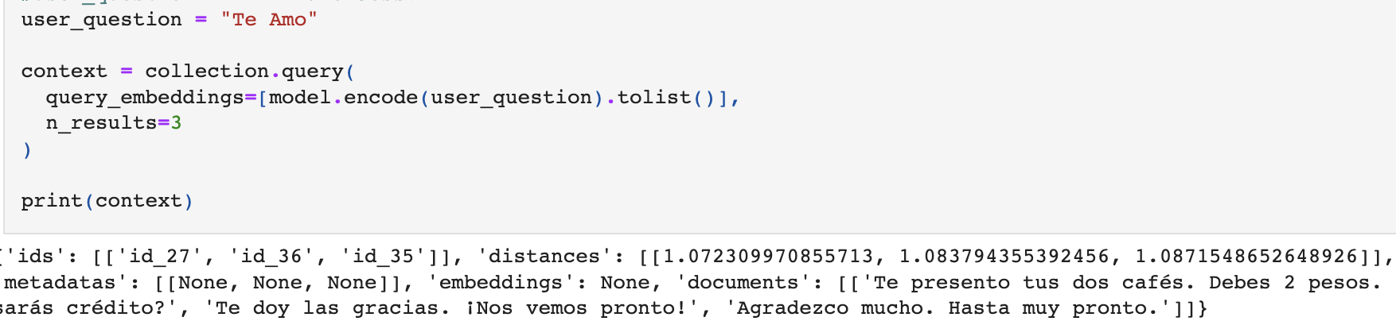
Content Classification Output
dataset
output1
output2
output3

Slide 41
Model Progress - Error Detection Task
Goal: Identify and classify errors in user response
Approach: Grammatical Error Correction (GEC)
Model: Enhancing Grammatical Error Correction Systems with Explanations
Dataset: Developing NLP Tools with a New Corpus of Learner Spanish: COWS-L2H: A corpus of Spanish learner writing
evidence words: python and chatGPT 4 prompt engineering
predicted parsing order: spaCy and nltk.parse

Slide 42
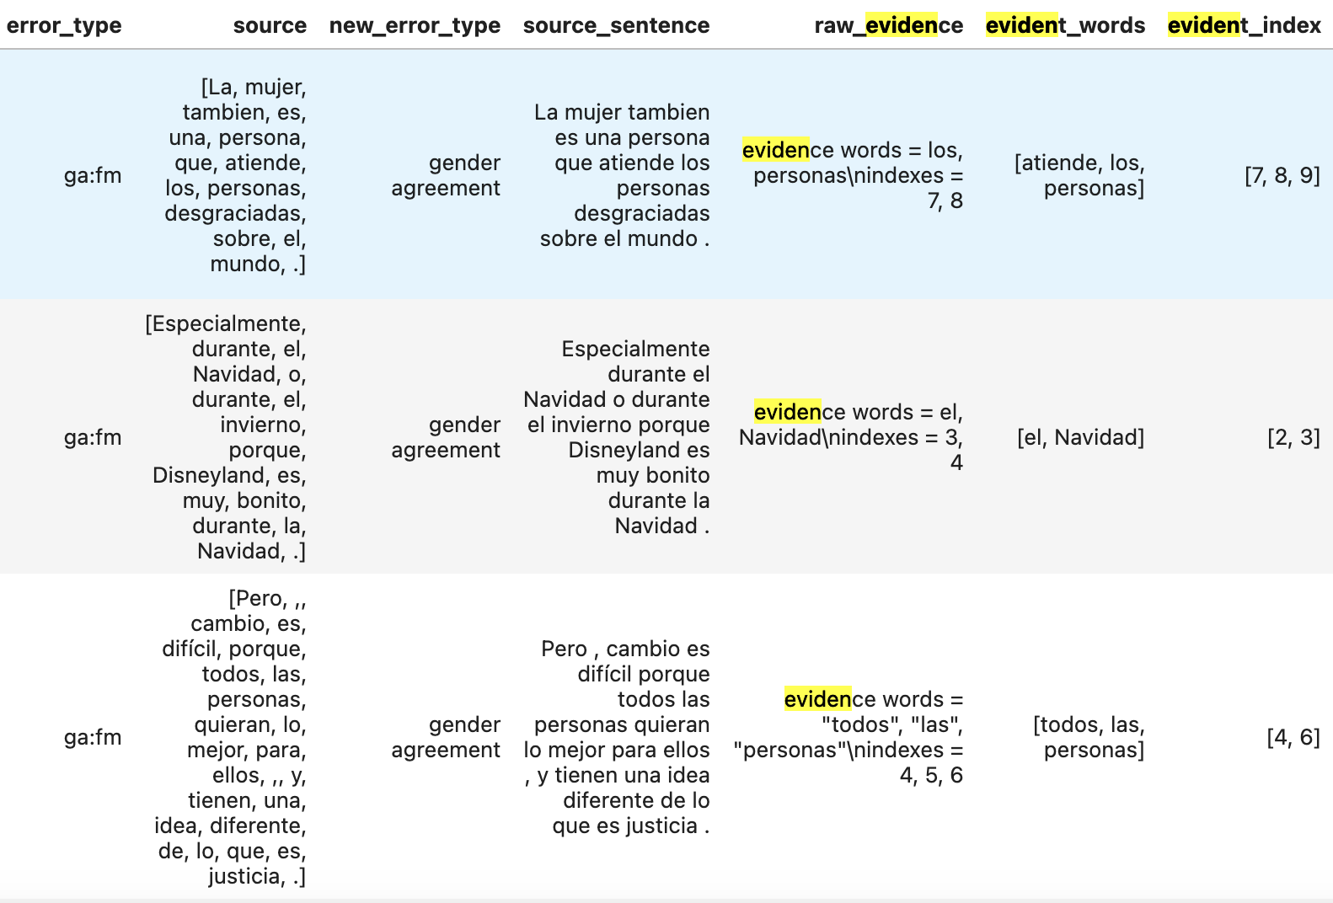
Evidence Words

Slide 43
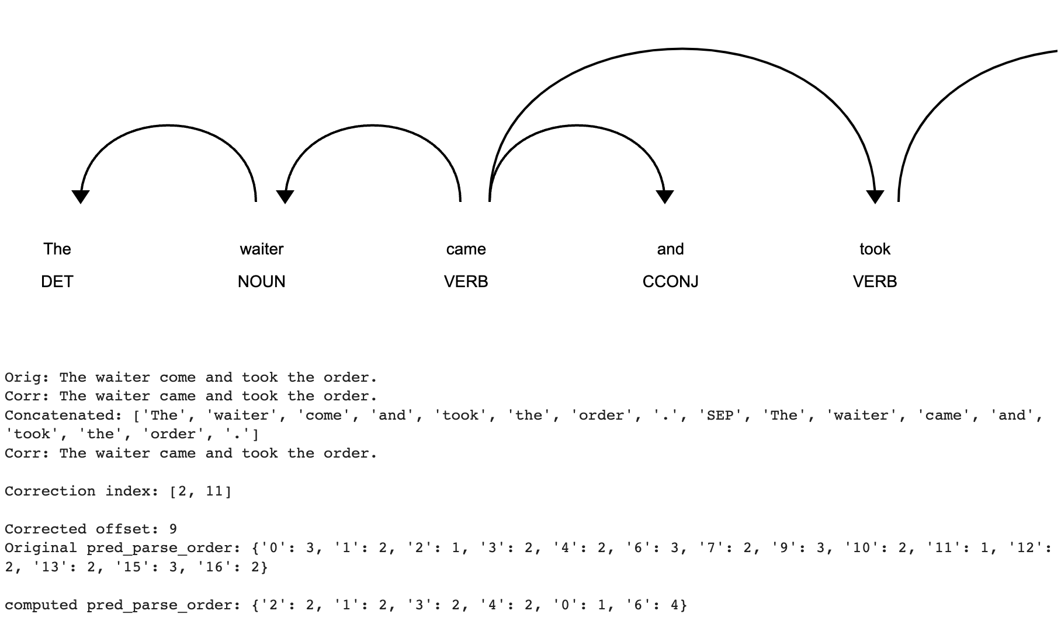
Predicted Parsing Order

Slide 44
Progress - Response Generation Task
Goal: Generate Cue/Scaffolding as well as response
Approach: LLMs and few shot learning with output from GEC model
LLM Model:
Falcon 7B Instruct
Falcon 7B
Introducing Ǎguila, a new open-source LLM for Spanish and Catalan
based on Falcon 7B
Fine-tune with a mixture of Spanish, Catalan and English data.
The training corpus consists of 26B tokens of several corpora gathered from web crawlings and public domain data.
Challenge: Aguila model does not do instruction. It only does text generation.

Slide 45
Conversationally: Next Steps (Week 11)
Models:
Creating evaluation metrics and tuning
Context Classification using F1: Isabel
GEC using F1: Ram
LLM using custom manual evaluation criteria: Jess + Mon
API:
Integration with models and testing: Aastha
UI:
Integrating with API response: Ram + Aastha
Creating summary modal: Ram
Testing:
Internal product testing: Everyone
User testing: Jess
Notes:
https://dev.d3fuj1q7y7z3gg.amplifyapp.com/convOneActual

